Slide 1
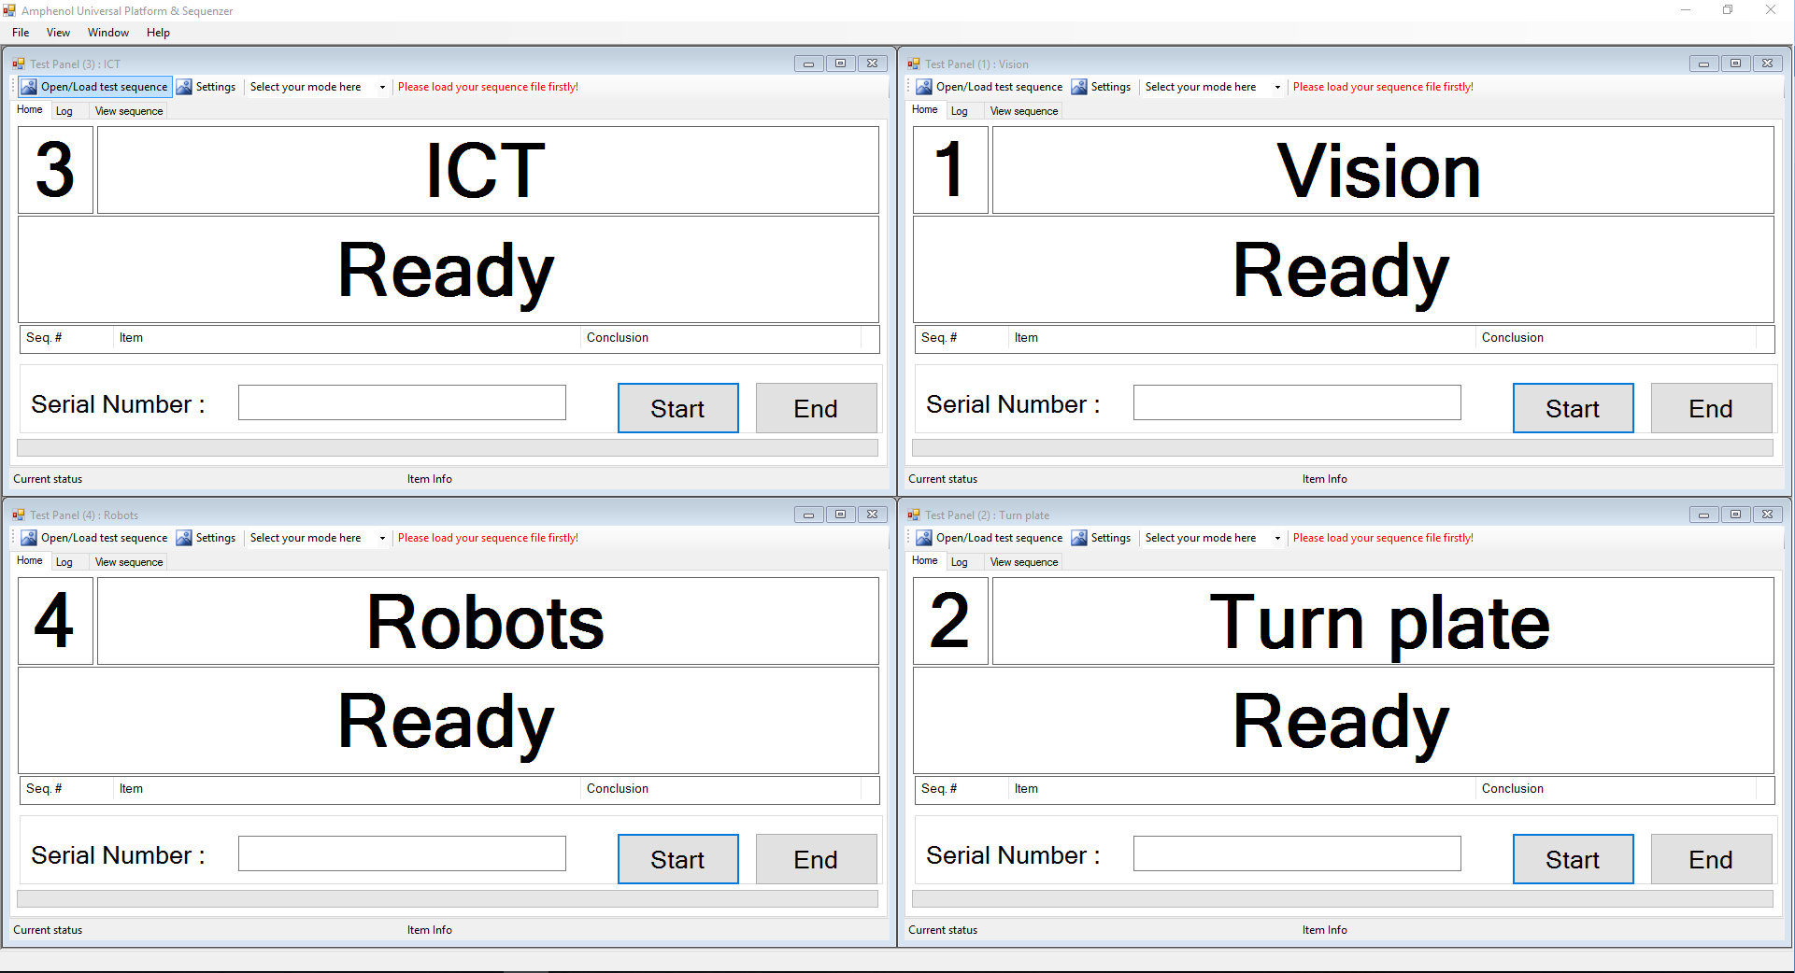
AUPS software system description
(AUPS : Amphenol Universal Platform & Sequenzer)

Slide 2
Contents
What is AUPS?
The features of AUPS
Sequence Editor module
Test Panel module

Slide 3
1. What is AUPS?
AUPS : Amphenol Universal Platform & Sequenzer
AUPS is a general testing platform, designed to perform project-specified test sequence / test items in a uniform UI, which is concise and intuitive.
It supports:
separated test panel manager, each test panel performs his own test sequence independently.
test engineer can freely customize his specific sequence, according to project specification.
provides the Sequence Editor, allow to organize test items and controlling orders agilely.
easy to extend and integrate various test equipments and instruments, by virtual of accessing different DLLs which software engineer programmed.
…… (more functions under continuous developing)

Slide 4
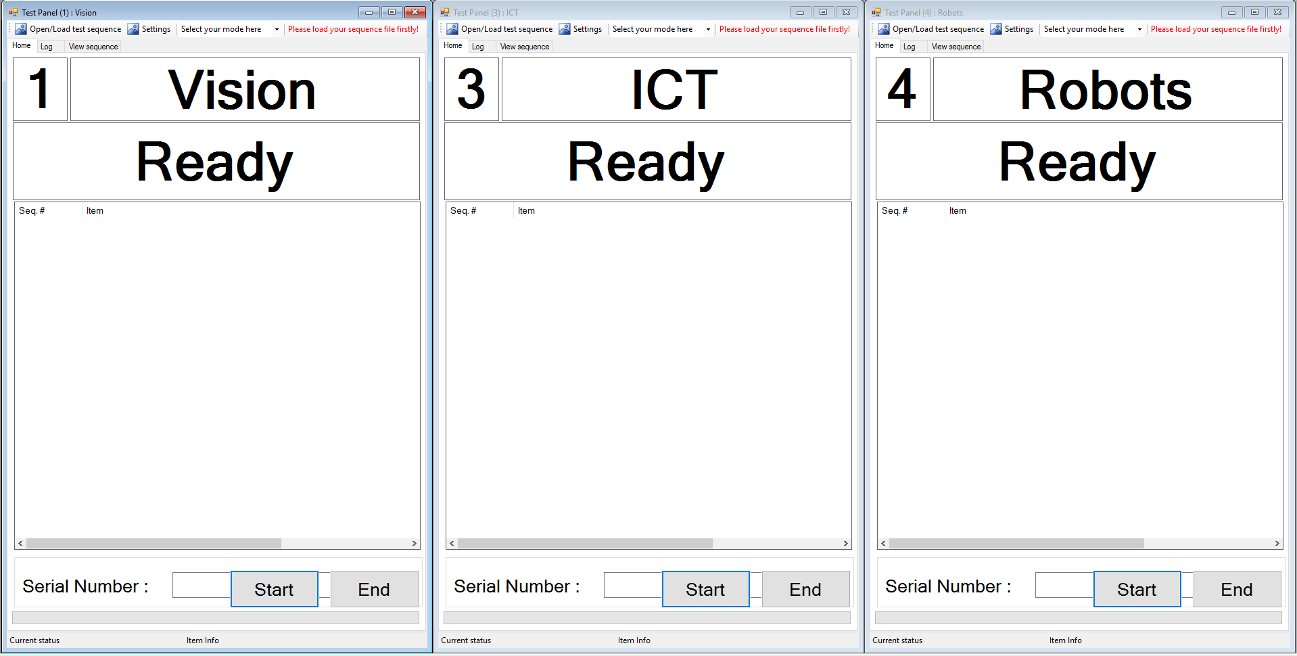
2. The features of AUPS
AUPS has the following feature modules :
separated test panels, independently execute each project (or station) – specific test sequence in parallel.

Slide 5
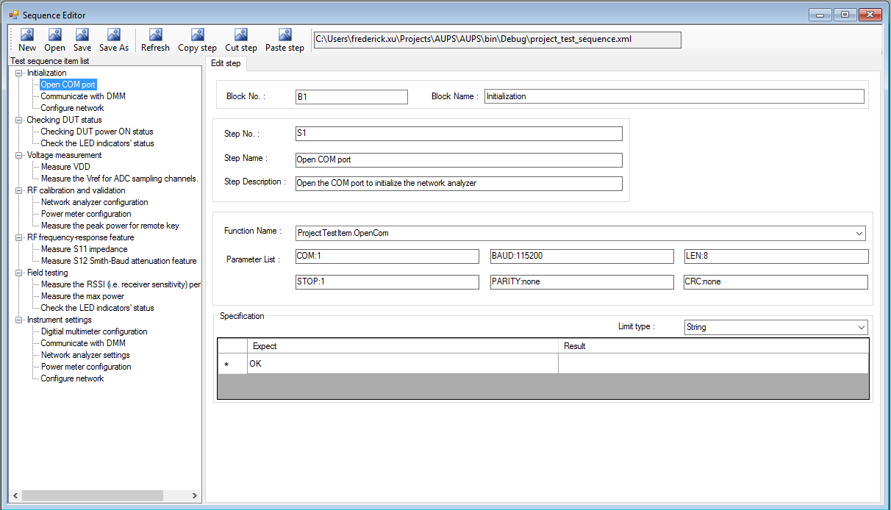
SequenceEditor feature module allows testing engineer to organize test items freely, according to project specification.

Slide 6
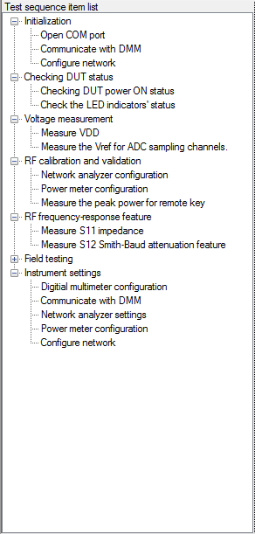
3. Sequence Editor module
Describe the functions of Sequence Editor module
in detail as below :
Test sequence item list
list all test blocks and steps in tree view, every step node
corresponds to one test item user defined.
The step order stands for the execution order, TestPanel
will perform testing item-by-item, strictly obey the
sequence order.
Test engineer can organize multiple steps into a test block,
easy to differentiate the test framework, according to
project specific requirement.
Block node
step node

Slide 8
To be continue…

